Slide 1



AuthEv-LKolb at
CheckThat! 2024 Task 5
A Two-Stage Approach To Evidence-Based Social Media Claim Verification
Luis Kolb, Allan Hanbury
@ TU Wien (Austria)

Slide 2
Briefly, an Overview
We already heard about the task – what was our approach?
Experiment with Retrieval Approaches
See if LLMs hold any promise for Verification
Experiment with NLP Methods for Retrieval & Verification
We don’t train a model, but approach this in a zero-shot fashion
“Authority” != Government Account (possible, but not necessary)

Slide 3
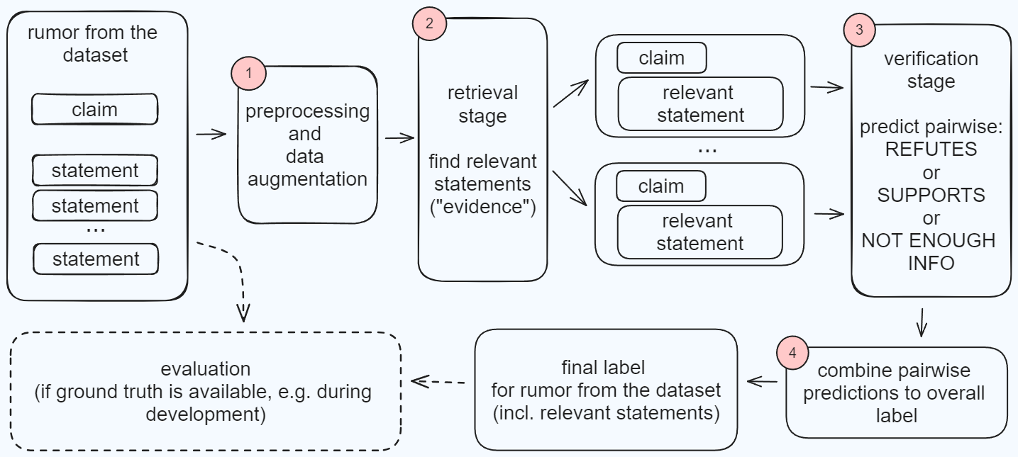
Our Two-Stage Approach (and task recap)
Notes:
This is our approach, and I’ll walk you through it as we move through this talk.

Slide 4
Our Two-Stage Approach (and task recap)
Notes:
First off, let’s start with the data. You’re already familiar with the task, so let’s just get a quick look at the data.

Slide 5
Let‘s look at an example
{
  "id": "AuRED_142",
  "claim": "Naturalization decree in preparation: Lebanese passports for
  sale?! https://t.co/UuQ7yMbSWJ https://t.co/Jf1K1NbZJD",
  “timeline": [
    ["https://twitter.com/LBpresidency", "1555424541509386240", "The Information Office of the Presidency of the Republic: What was published by the French newspaper “Liberation” about the “selling” of Lebanese passports to non-Lebanese is false and baseless news."], ...
  ], …
}
Notes:
This is what a rumor from the dataset looks like…

Slide 6
Let‘s look at an example
{
  "id": "AuRED_142",
  "claim": "Naturalization decree in preparation: Lebanese passports for
  sale?! https://t.co/UuQ7yMbSWJ https://t.co/Jf1K1NbZJD",
  "timeline": [
    ["https://twitter.com/LBpresidency", "1555424541509386240", "The Information Office of the Presidency of the Republic: What was published by the French newspaper “Liberation” about the “selling” of Lebanese passports to non-Lebanese is false and baseless news."], ...
  ], …
}
Notes:
…but we can get some extra data from here. The claim is “anonymous”, but the Authority Account is not. So, we got the Display Name and Bio from Twitter, and wanted to see if we can improve results.
We can also test if preprocessing could be beneficial.

Slide 7
Our Two-Stage Approach
Notes:
Once we have the timelines ready, we need to pick our Evidence we can use later. This is the Retrieval step. Let’s take a look.

Slide 8
Retrieval Stage – Goals and Approach
Retrieve relevant tweets from authority account timelines
Lexical methods: BM25, TF-IDF
Semantic methods: Embedding Models & Cosine Similarity
Does preprocessing or additional info about the authority improve Recall?
Balancing retrieval speed and accuracy → Re-Ranking?

Slide 9
Our Two-Stage Approach

Slide 10
Verification Stage – Strategy and Models
Verify claim support using retrieved evidence
Basically Natural Language Inference (NLI)
Models: BERT Variants fine-tuned for NLI, GPT-4, Llama-3
Focus on natural language reasoning: how complex would the language model need to be?

Slide 11
Our Two-Stage Approach

Slide 12
Performance Metrics (CheckThat! Task 5)
Retrieval: Recall@5, Mean Average Precision
Verification: Macro-F1 (balance of Precision and Recall),
Strict-Macro-F1

Slide 13
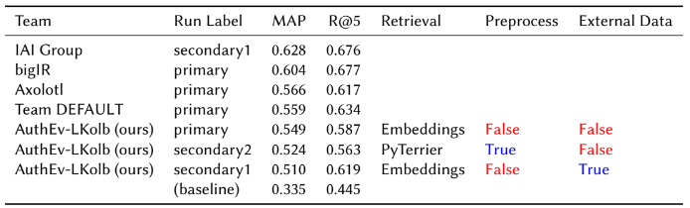
Leaderboard – Retrieval (English)

Slide 14
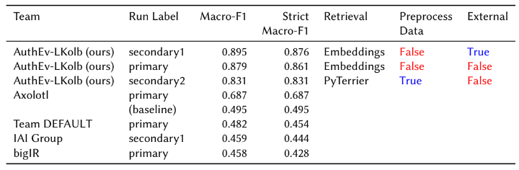
Leaderboard – Verification (English)

Slide 15
Key Findings – Retrieval Stage
Best* performance via the Terrier implementation of PL2 with some stemming, etc. (divergence-from-randomness lexical method)
  *at the time of submission
On average, using Terrier over OpenAI embeddings and cosine similarity yielded a Macro-F1 improvement of +0.0239
However, the performance gap is small – on the leaderboard, OpenAI embeddings were our best performing retriever method

Slide 16
Key Findings – Verification Stage
LLMs are indeed capable of the inference step to determine support or refutal based on the claim-evidence pairing
BERT variants fine-tuned on NLI datasets did not generalize well to this task
GPT-4-Turbo was much more reliable & performant than Llama3-70b (expected outcome)

Slide 17
Key Findings – Features
In our experiments, the best settings were:
  NO preprocessing done to claim and evidence
  NO additional author data added to the evidence (display-name & bio)
  Giving a lot of weight to each piece of evidence was beneficial
    (ignoring individual “NOT ENOUGH INFO” claim-evidence pairings in the overall rumor labelling decision, as the evidence was likely unrelated to the claim, and we always pass 5 pairings to the verification stage)

Slide 18
Findings since Submission Deadline (1/2)
A capable enough LLM with correct temperature settings is stable and does not just happen to hallucinate the correct labels
A re-ranking pipeline of
BM25 >> (%top-50) >> NV-Retriever-V1 >>(%top-5)
performed very well for retrieval (0.71 R@5 on combined train & dev)
In fact, this pipeline performed the best out of everything we tried later (lexical & semantic methods)
Notes:
I’ve participated in this shared task as part of my Master’s Thesis, as such I’ve made some more findings since…

Slide 19
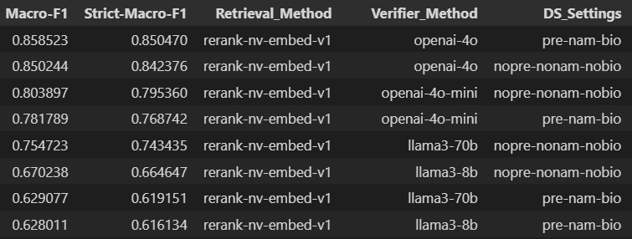
Findings since Submission Deadline (2/2)
The “weight class” of GPT-4o class of models is a good balance of capability & cost (a bit better than Llama-3.1-70b)
Verification experiment results on the
combined (train & dev) dataset
Notes:
I’ve participated in this shared task as part of my Master’s Thesis, as such I’ve made some more findings since…

Slide 20
Caveats & Discussion
LLMs-as-a-Service are subject to proprietary moderation (and sensitive topics are to be expected when dealing with rumors)
  Ideally, you would use your own models, and fine-tune them continually on real data
Scalability would require trade-offs
This Lab task did not cover finding the authority account timelines our system relies on – this is an entirely separate task
Multimodality – we did not use images & video content in our approach, though this could be integrated given the multimodal models today

Slide 21
Potential for Future Work
Multimodality
Multilingualism
Integration of more “meta-data” (for example: social graph, or interactions between claim and evidence – was the evidence a response/quote-tweet, or none of these?)
If we’re already using LLMs – explainability! (via generation of “justifications”)

Slide 22
Conclusion
We submitted the best performing system to the
CheckThat! Lab Task 5 (English)
LLMs can work as powerful language inference agents
There is already plenty of distrust in AI (especially LLMs) today! Science communication is important to build trust in systems like this

Slide 23

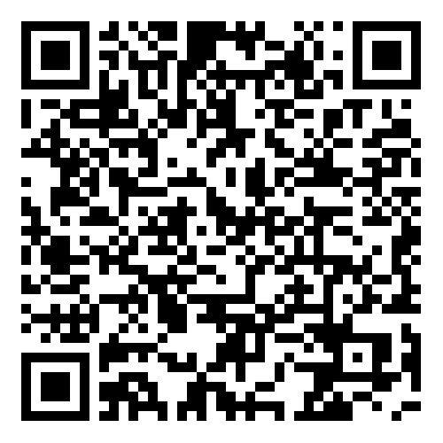
Thank you! Questions?
Slides on GitHub ⬇️
Contact Info at luiskolb.at

